Slide 1



PROBLEM STATEMENT
Mobile robots must accurately follow a desired trajectory while rejecting disturbances and handling nonlinear dynamics​.
Traditional control methods like PID struggle with environmental variations, system uncertainties, and disturbances​.
Manual tuning of Active Disturbance Rejection Control (ADRC) parameters is time-consuming and suboptimal in dynamic environments​.

Slide 2


MOTIVATION
ADRC provides robust disturbance rejection but requires precise parameter tuning for optimal performance.
01
02
Reinforcement Learning (RL) dynamically tunes controller parameters by learning through interactions with the environment.
03
The hybrid approach of RL-tuned ADRC enables adaptive control, improving trajectory tracking performance in complex, uncertain scenarios.

Slide 3

OBJECTIVE
Demonstrate improved trajectory tracking and disturbance rejection capabilities through simulations using RL tuned ADRC.

Slide 4
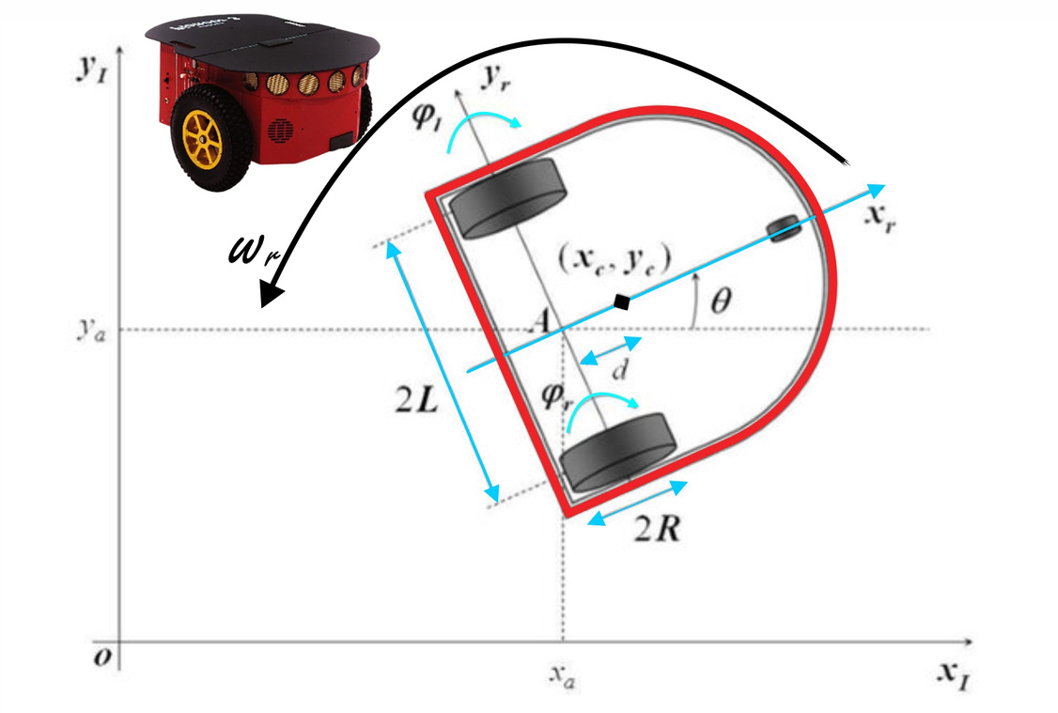
ROBOT PLATFORM
The Differential Drive Mobile Robot (DDMR) is widely used for its simplicity and control efficiency, especially in indoor applications.
It has two independently driven wheels on either side, enabling forward, backward, and rotational motion by adjusting the wheels' angular velocities​.
(xc​ ,yc​): Center coordinates of the robot.
(2L): Distance between the two wheels.
(2R): Distance from the wheel center to the point on the arc path.
(ϕr, ϕl)​: Rotation angles of the right and left wheels.
(xr, yr): Coordinates of the target point.

Slide 5

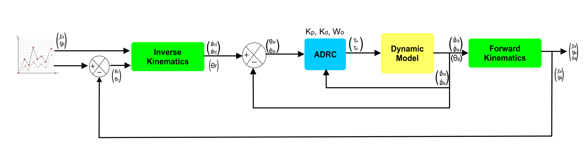
KINEMATIC MODEL
Forward Kinematics Block
The forward kinematics block determines the robot's position and orientation (x, y, Θ) by integrating the linear and angular velocities (v, ω), which are calculated using the wheel angular velocities (ϕ˙l, ϕ˙r) and robot parameters. It outputs the real-time pose of the robot for trajectory tracking.
Inverse Kinematics Block
The inverse kinematics block computes the angular velocities of the left and right wheels (ϕ˙l, ϕ˙r) from the desired linear and angular velocities (v, ω), which are derived from the input trajectory signals. It uses robot-specific parameters such as wheel radius (R) and wheelbase (L) for these calculations.

Slide 6
KINEMATIC MODEL
The key equatons used in kinematics model are as follows.

Slide 7
DYNAMIC MODEL
The dynamic model block calculates the torques (τl, τr) required for the left and right wheels based on the input wheel angular velocities (ϕ˙l, ϕ˙r) and the ADRC controller's parameters. Its purpose is to simulate the robot's physical behavior and ensure accurate motion control.

Slide 8
CONTROL DESIGN
The control structure processes the error signals from the left and right wheels, feeding them into the controller, which outputs the corresponding torque for each wheel. This structure is composed of two essential components:
Active Disturbance Rejection Control (ADRC)
reinforcement Learning (RL)

Slide 9
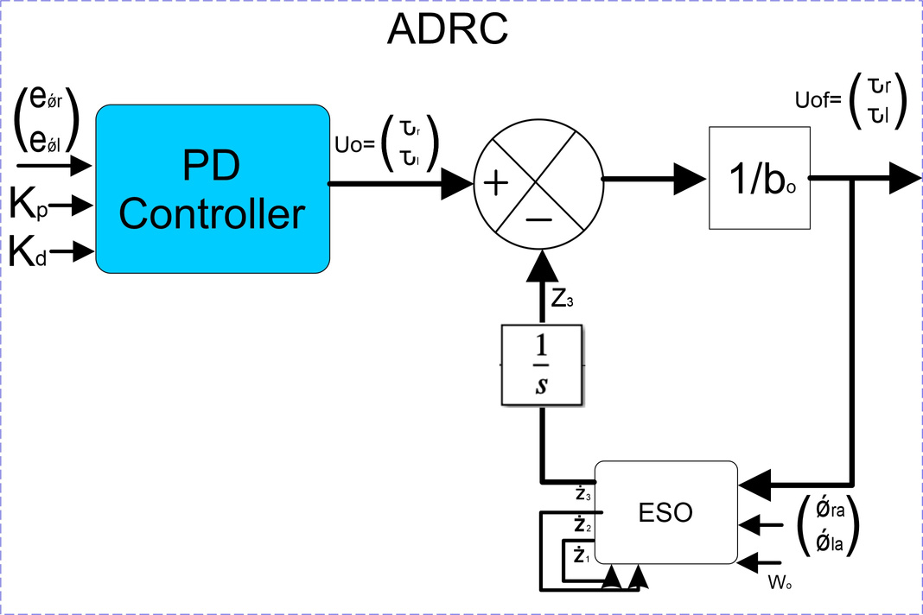


ACTIVE DISTURBANCE REJECTION CONTROL
In this design, a first-order ADRC is implemented. This focuses on rejecting disturbances and stabilizing the states for trajectory tracking.
ADRC consists of PD-controller that generates control signals based on error terms and tuning parameters (Kp​, Kd​) . Extended State Observer (ESO), estimates unmeasured states and disturbances, improving disturbance rejection. Outputs: z1 and z2 obtained as.

Slide 10
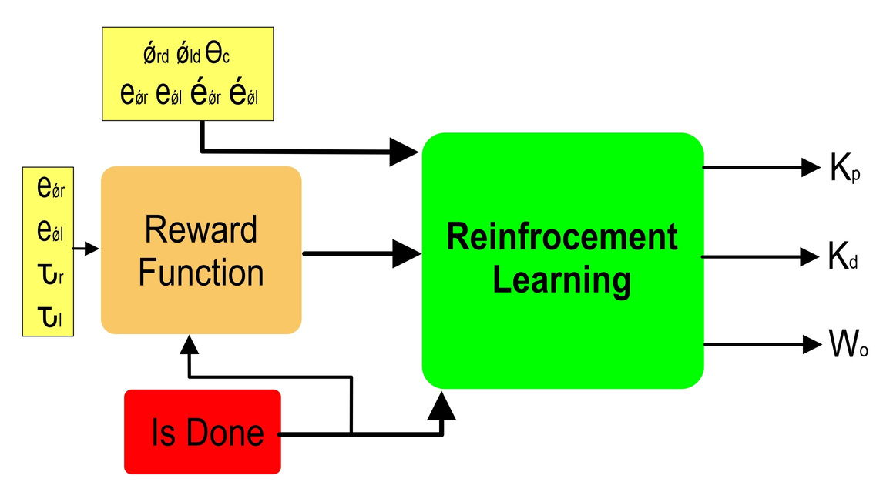
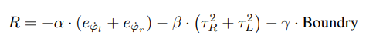
REINFORCEMENT LEARNING
Reinforcement Learning (RL) is utilized to tune the parameters of the ADRC controller by leveraging a continuous control framework. The RL agent receives inputs including the tracking errors (eϕ˙r, eϕ˙l), control torques (τr, τl), additional state variables and orientation angle (Θc). These inputs allow the agent to understand the system's dynamics and performance. Based on this, the agent outputs the optimal values of the ADRC parameters, namely the proportional gain (Kp), derivative gain (Kd), and observer gain weight (Wo).
The reward function is central to the learning process, encouraging accurate trajectory tracking by penalizing large tracking errors and control efforts. This function is typically defined as a negative combination of squared tracking errors and control torques, weighted by factors to balance their influence.

Slide 11
METHODOLOGY
In the proposed system, RL is employed to tune the parameters of an ADRC to control a differential drive robot. The RL framework involves multiple components that interact to optimize the controller's performance. The process begins with the RL agent receiving input signals from the system, including tracking errors of angular velocities (ϕ˙r, ϕ˙l), the control torques (τr, τl), and the orientation angle (Θc). These inputs inform the agent about the system's current state and control performance.
The agent uses this information to generate output parameters, specifically the proportional gain (Kp), derivative gain (Kd), and observer weight (Wo), which are passed to the ADRC controller. The reward function evaluates the system's performance by considering the tracking error and control efforts, ensuring the RL agent is guided toward minimizing error while optimizing control efficiency. This iterative process ensures that the RL agent systematically learns to adjust the ADRC parameters to optimize the torque signal based on disturbances and exhibits accurate trajectory tracking and better states estimation.

Slide 12
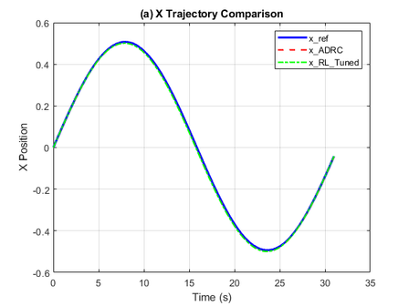
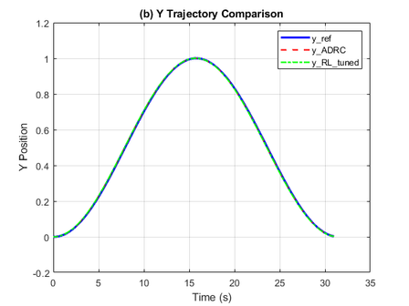
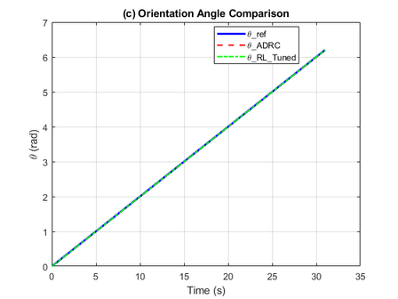
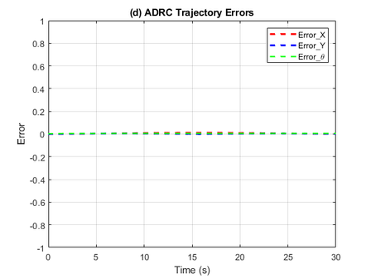
RESULTS
Figures below shows the x, y & θ tracking of the desired input trajectory, the robot’s actual trajectory using ADRC and RL-tuned ADRC for a circular motion. It can be observed from the figures that the estimation of the trajectory is almost perfect, where trajectories overlap entirely. This signifies that ESO was well-tuned. Also, RL-tuned ADRC can follow the desired trajectory
X axis Trajectory
Y-axis Trajectory
Theta Tracking
Error Signals

Slide 13
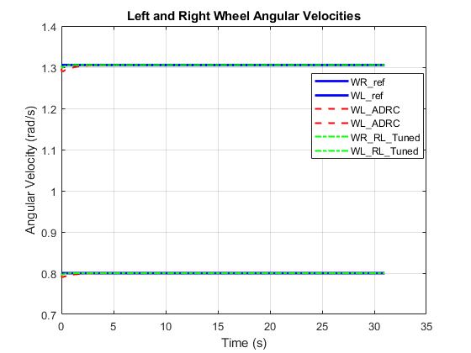
RESULTS
Figure illustrates the angular velocities of the left and right wheels for the desired trajectory, the ADRC controller, and the RL-tuned ADRC controller. The signals exhibit initial oscillations before stabilizing and closely following the desired angular velocities. The results indicate that both techniques successfully achieve accurate tracking of the desired angular velocity, but RL-tuned ADRC exhibits negligible oscillation compared to manual-tuned ADRC.

Slide 14
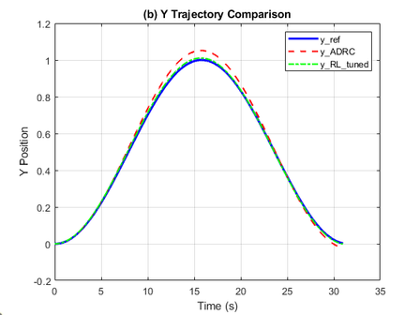
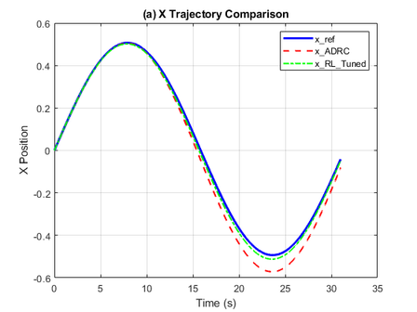
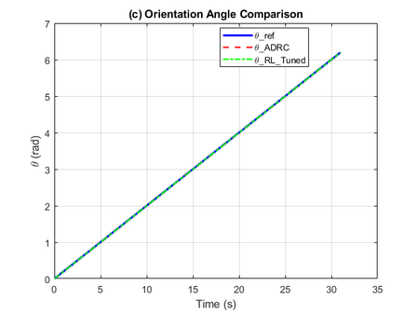
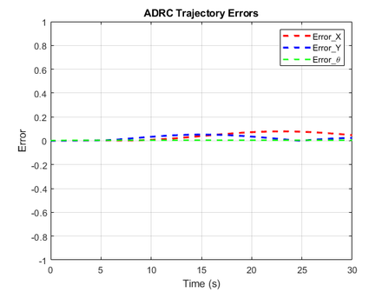
RESULTS
Figures below shows the x, y & θ trajectory tracking results and errors after adding a step disturbance at t=5 seconds with a magnitude of 0.2. It is visible from the graph that, as the continuous disturbance appears, the robot starts to deviate from the trajectory, and ADRC can compensate for the disturbance, but RL-tuned ADRC shows better performance. Also, the system was tested on pulse disturbance of magnitude 0.5 applied at t=5 seconds and sinusoidal disturbance of magnitude 0.5 applied at t=5 seconds. Results show that the RL-tuned controller performs well compared to the results obtained with the manually tuned ADRC. The trajectory errors of RL-tuned ADRC are less than those of the manual-tuned ADRC, which indicates better performance.
X axis Trajectory
Y-axis Trajectory
Theta Tracking
Error Signals

Slide 15
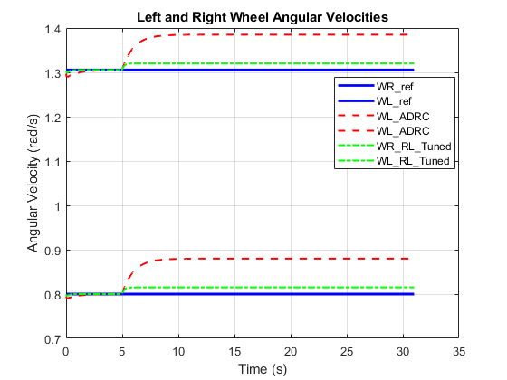
RESULTS
Figure shows the left and right angular velocity errors after adding a step disturbance. It can be observed that RL-tuned ADRC slightly increases the angular velocities compared to the manually-tuned ADRC to keep the robot on a circular path.

Slide 16
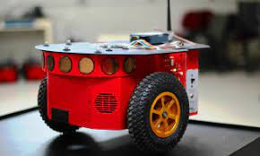
THANK YOU
Any Questions?

